Slide 1


Predicting Covid-19 Cases and Deaths in USA: A ML Regression Project
Prakash Parajuli, PhD
Data Science Capstone Project, 2021
Thanks to Springboard Mentor:
Ajith Kumar

Slide 2
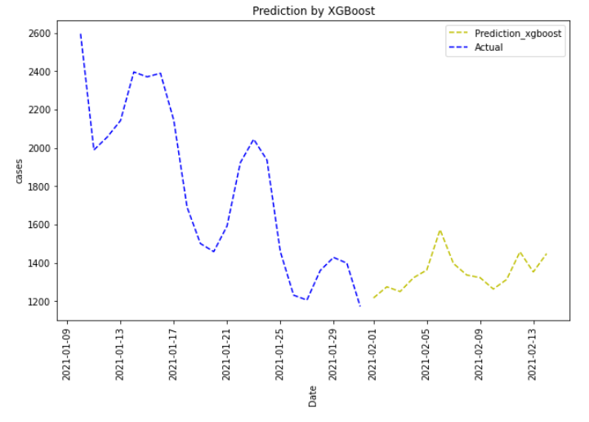
Project Overview
Problem:
What major What major factors affects the rise in Covid-19 cases and deaths? Can we predict Covid-19 cases and deaths for future to provide guidance to the corresponding authorities aiming to prepare them in advance?
Datasets
Covid-19 Cases and Deaths, Public Holidays/celebrations, Weather, Air_Traffic, Mobility
Forecasting
Data Wrangling, EDA (inferential statistics), Feature engineering,
and Preprocessing
Supervised Classification Algorithms /Evaluation (MAPE)/ Hyperparameter tuning
Top factors that affect the loan repayment ability: Days since outbreak, lag_14 cases, and lag_14_holiday_surge_cases.
Cases and deaths are not declining for the next 14 days, hence precautionary measures should be adopted.

Slide 3

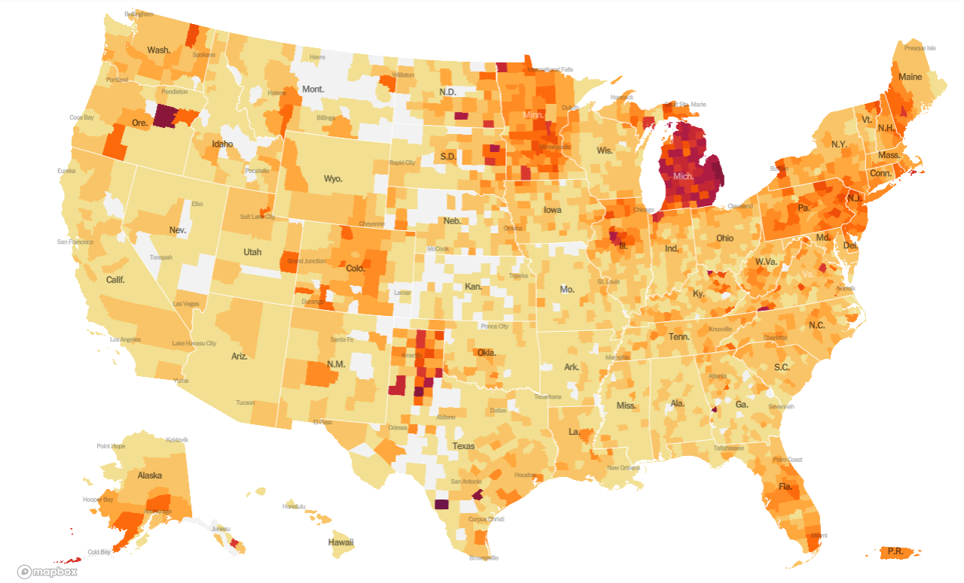

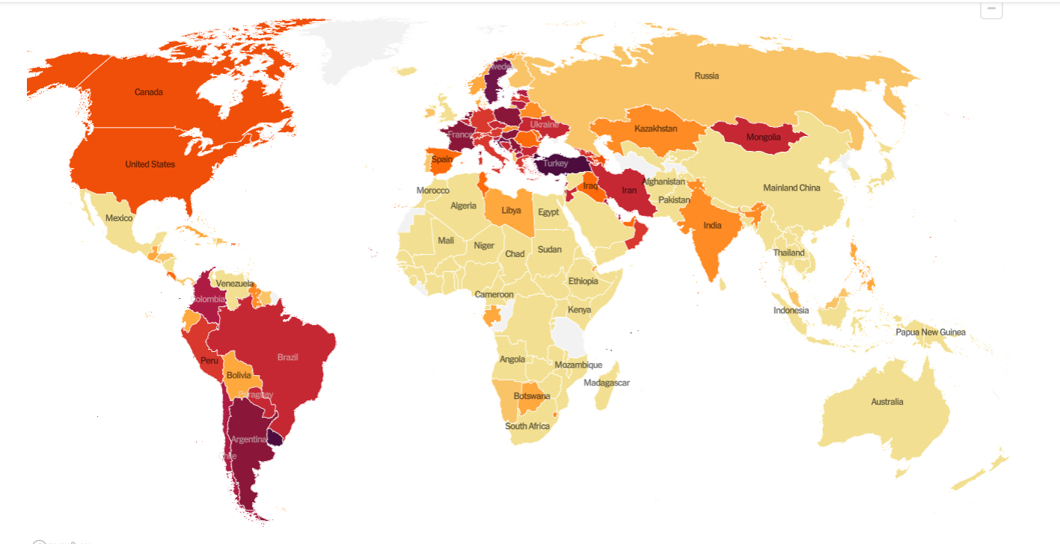
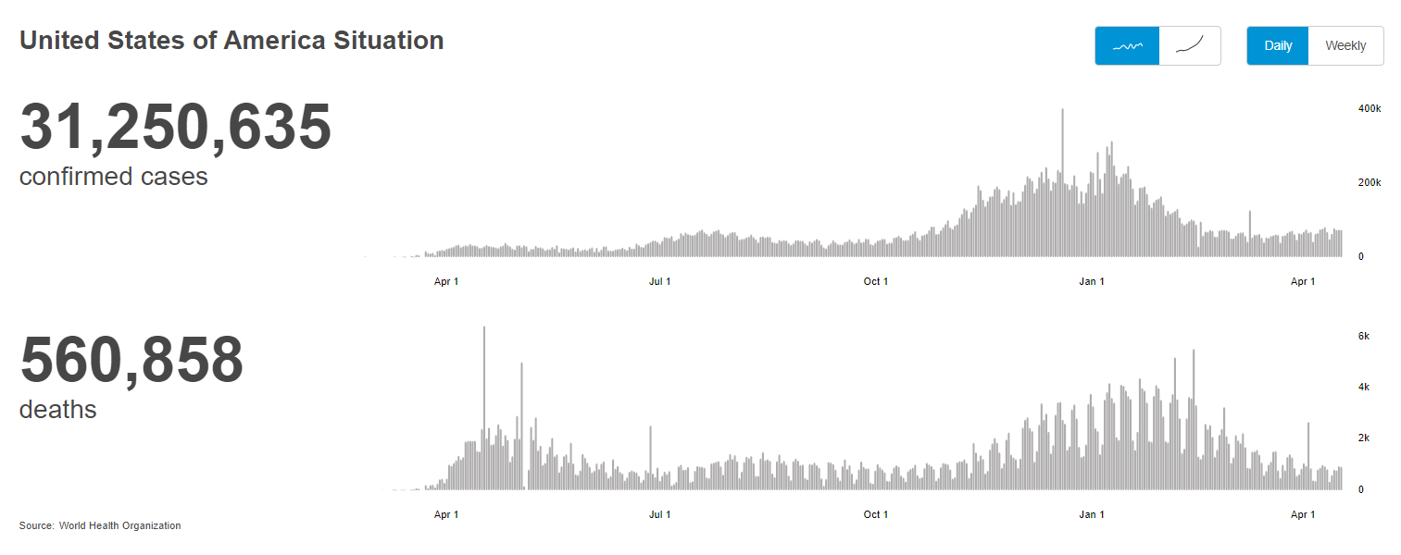
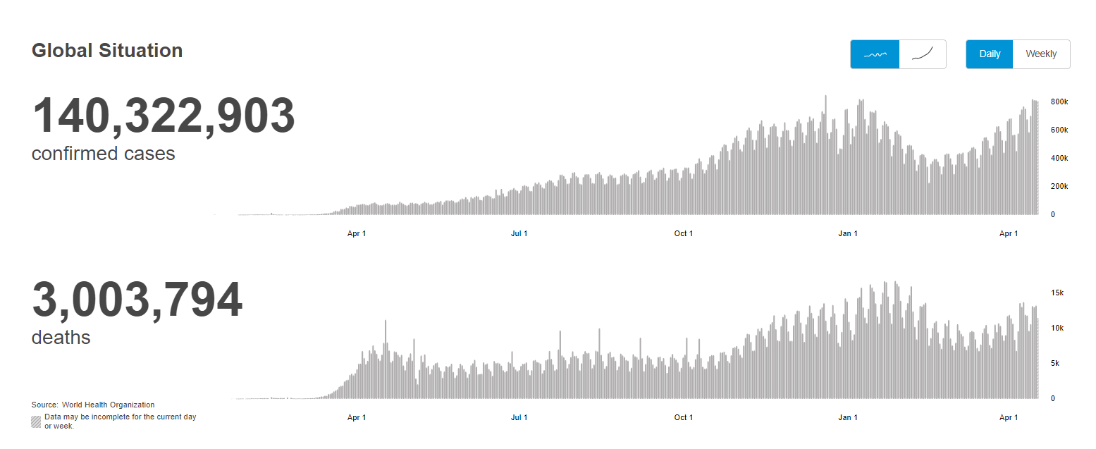
The Problem
In general, the mortgage application denial rate approx. 8%
Covid Cases and Deaths are uncontrolled even after 1 year after the outbreak. (Data as of 04/18/2021)
What major factors affects the rise in Covid-19 cases and deaths?
Can we predict Covid-19 cases and deaths for future to provide guidance to the corresponding authorities aiming to prepare them in advance?

Slide 4



Who might be benefitted?
National/international Regulatory agencies
Businessman and General Public
State health governing bodies

Slide 5



Data Extraction:
What factors might affect the surge in covid-19 cases and deaths?
Covid-19 Cases and deaths till now
(The New York Times)
People’s Mobility Data (U.S. Department of Transportation)
Public holidays, Various Events and Covid-19 Mitigation efforts (Various federal and statewide regulatory bodies)
Climate Data
(National Center for environmental information)

Slide 6
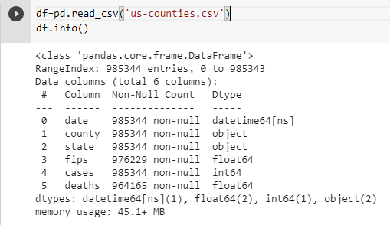
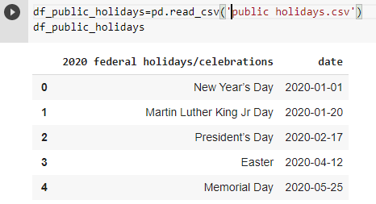
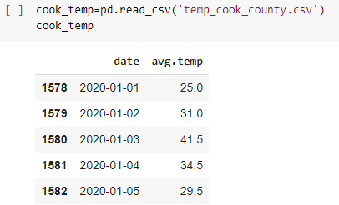
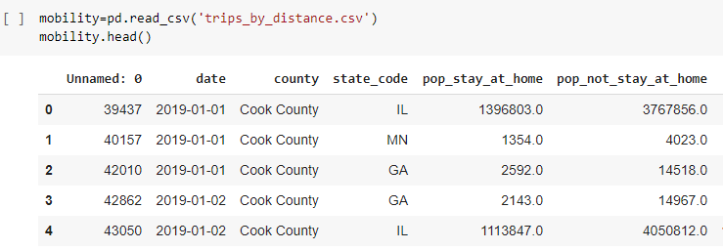
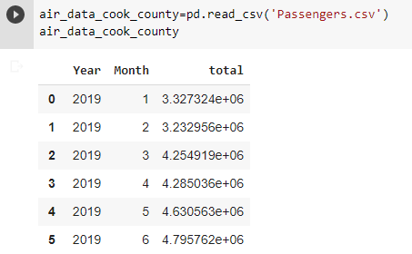
Data Exploration:
Primary Data: Covid-19 Cases and Deaths
Additional Data:
Public holidays/Celebrations
Weather
There is total 985343 rows representing the information of covid-19 cases, deaths from various counties of USA starting from 2020-01-24 to 2021-01-31.
No any missing values.
Mobility
Air_Traffic

Slide 7
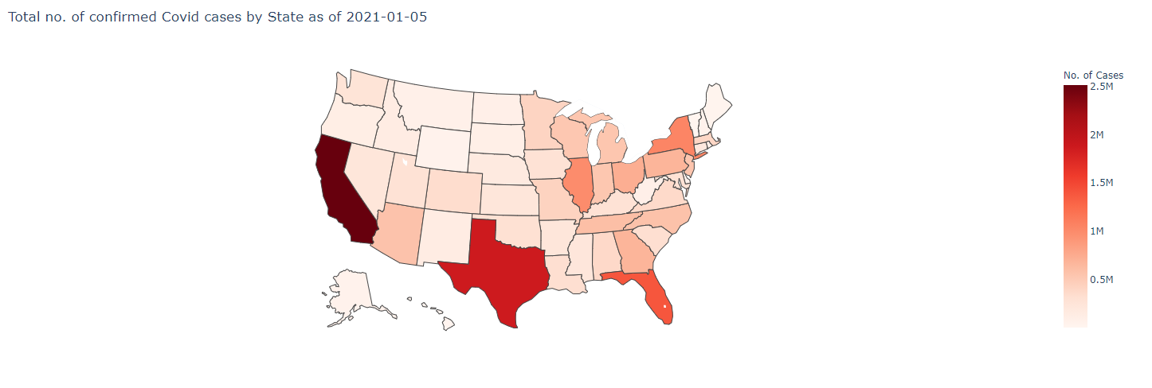
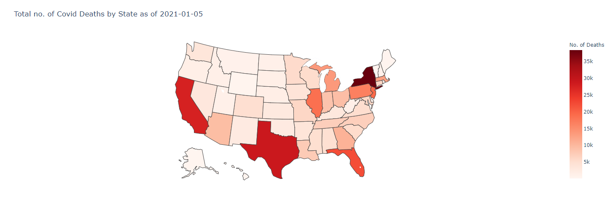
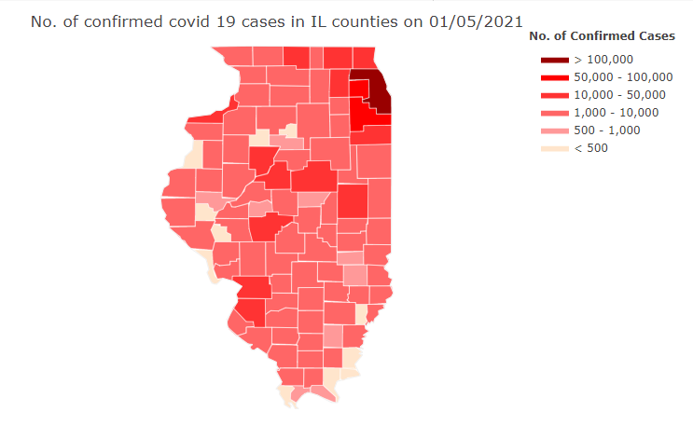
EDA: Covid-19 Cases/Deaths
Majority of confirmed cases and deaths corresponds to the California, Texas, Florida, New York and Illinois.
Majority of confirmed cases in Illinois corresponds to Cook County.

Slide 8
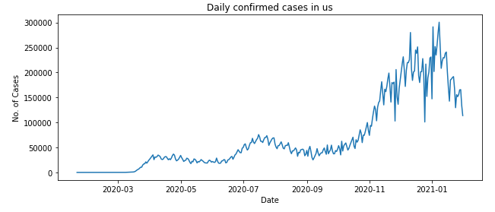
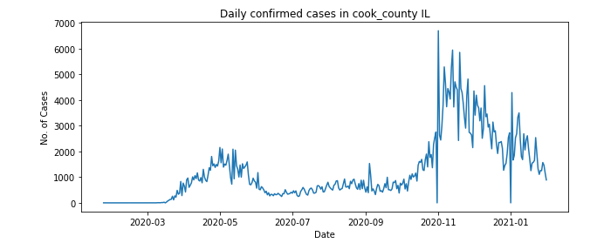
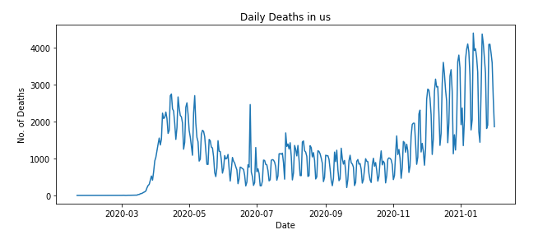
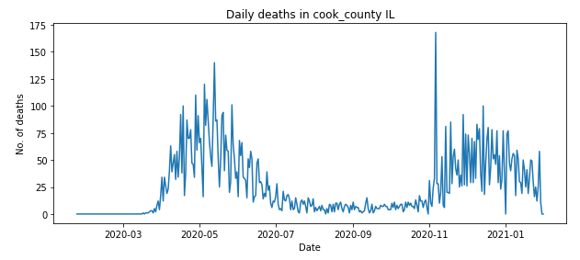
EDA: Covid-19 Cases/Deaths
Cases and Deaths are still alarming, there are several spikes in the data, hence the moving average will be used for further analysis

Slide 9
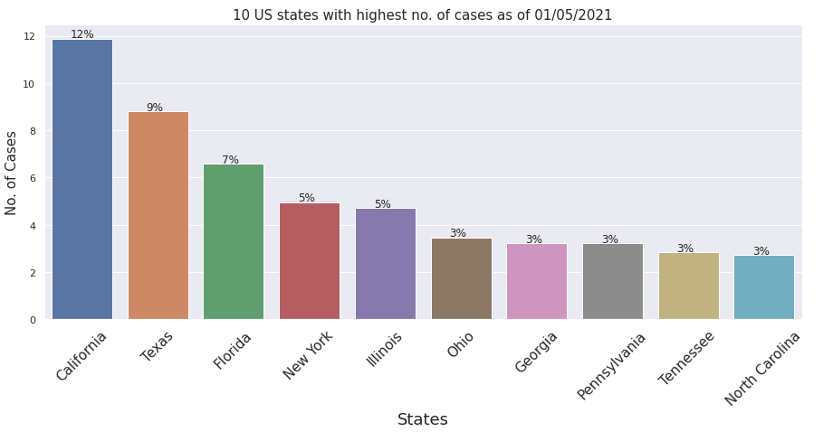
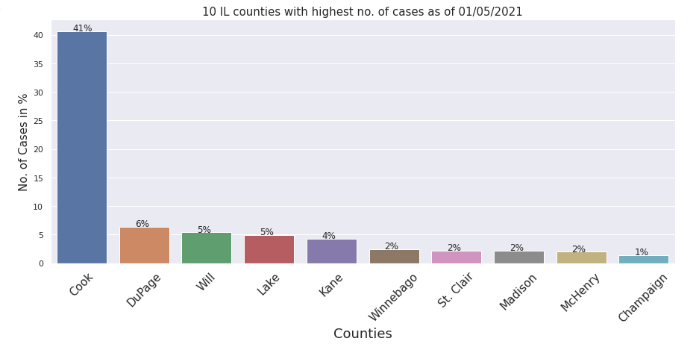
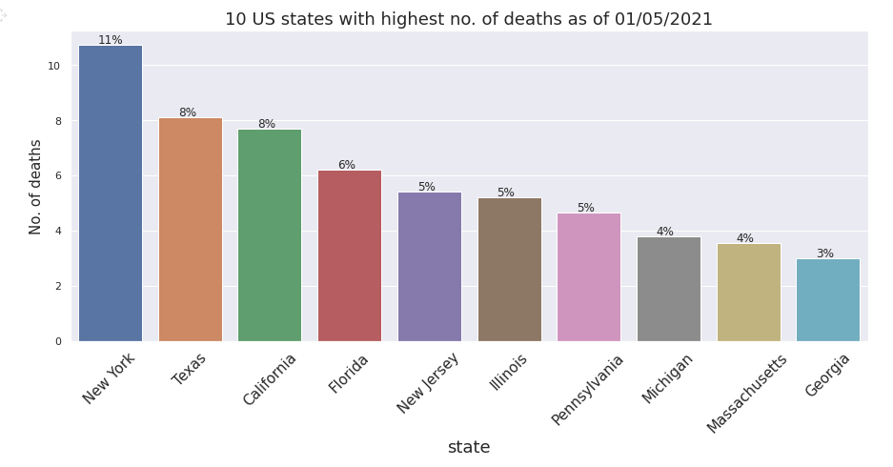
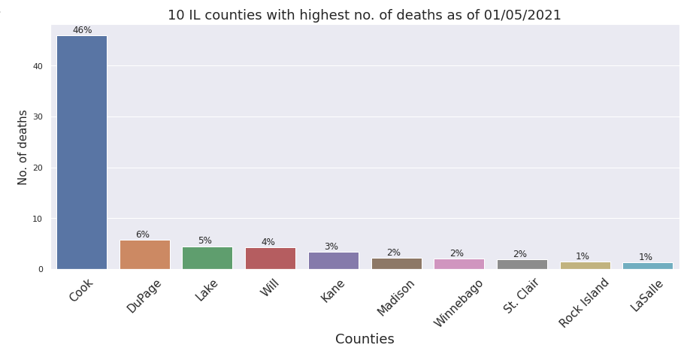
EDA: Covid-19 Cases/Deaths

Slide 10
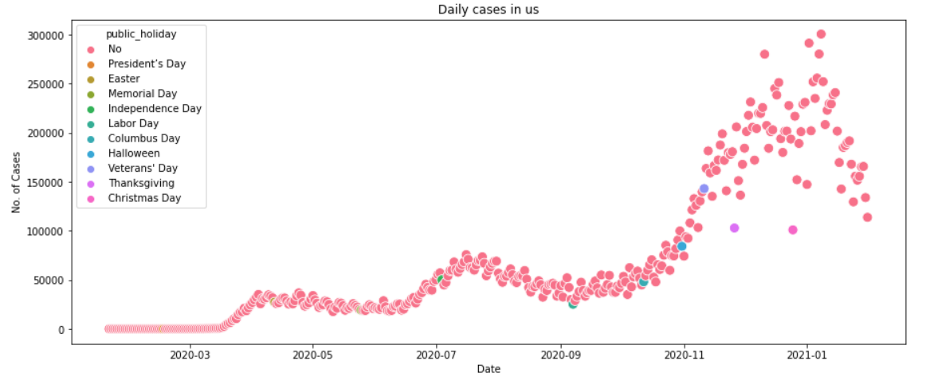
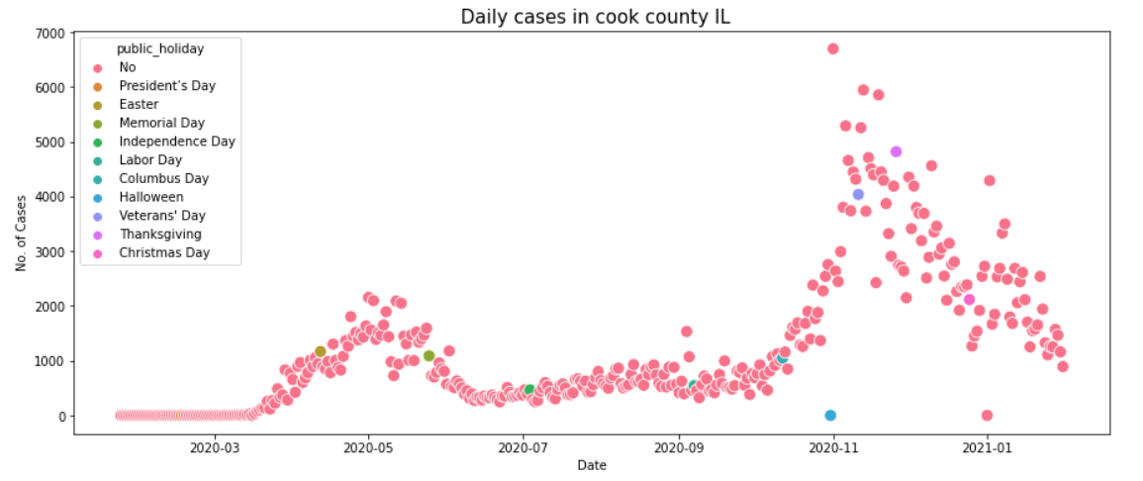
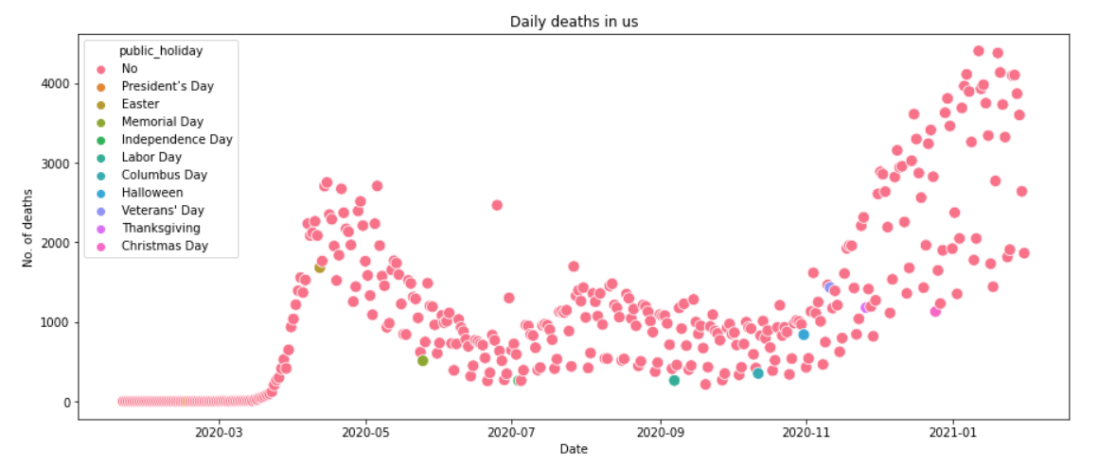
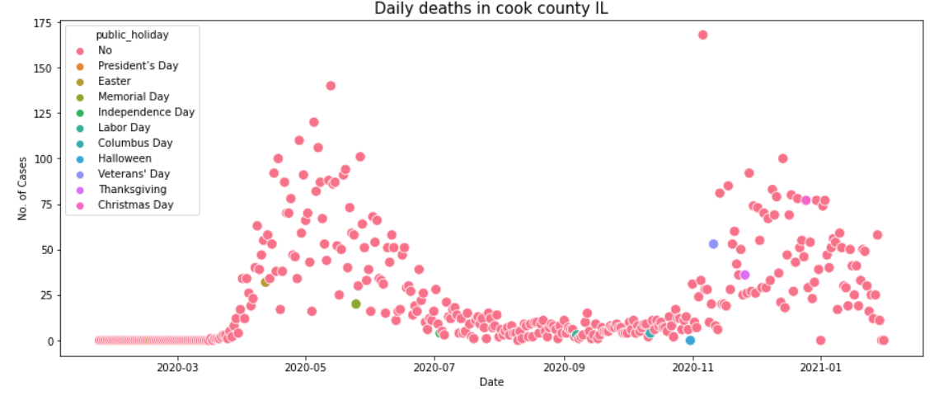
EDA: Does public holidays contributed for surge in cases and deaths
Not all holidays are contributing for surge in cases and deaths, Let’s dive into individual day/event?

Slide 11
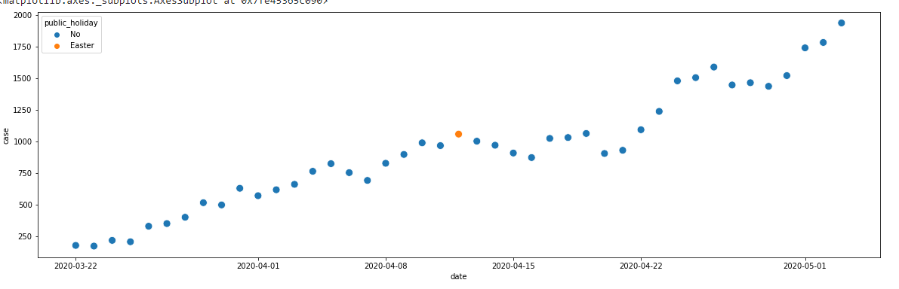
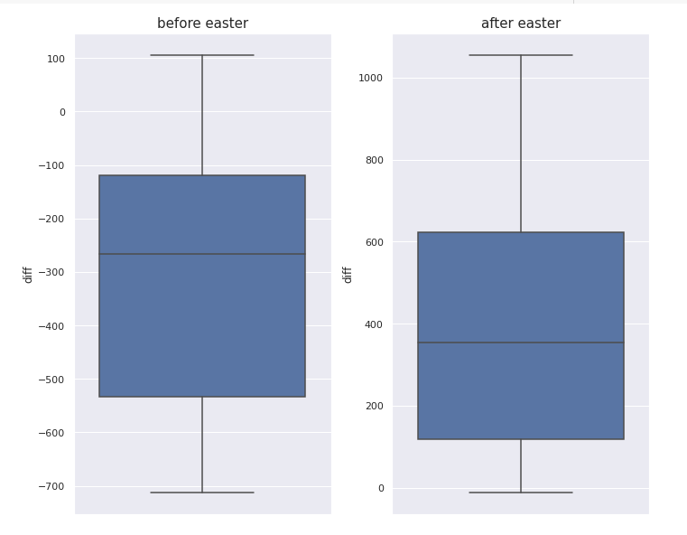

EDA: Does public holidays contributed for surge in cases and deaths
ANOVA Testing 7 day moving average before/after 14 days
Yes, Easter contributed for case surges.

Slide 12
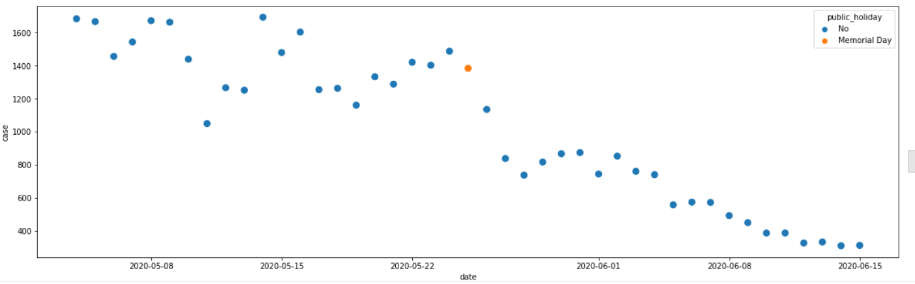
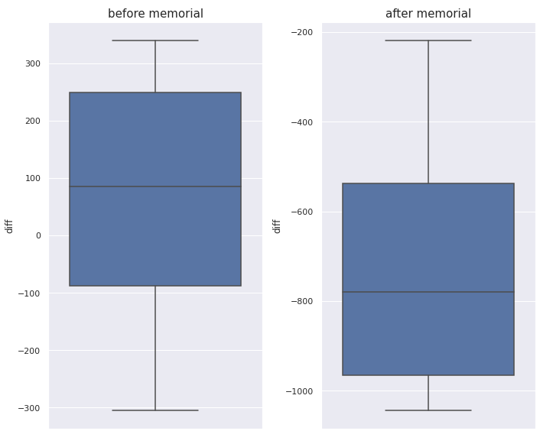

EDA: Does public holidays contributed for surge in cases and deaths
Data shows cases decreased after memorial day. For me, this is due to the natural decrease in cases after first peak.

Slide 13
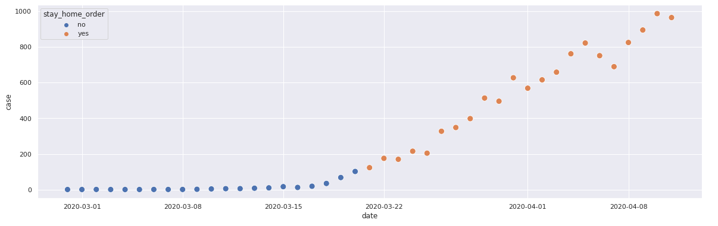
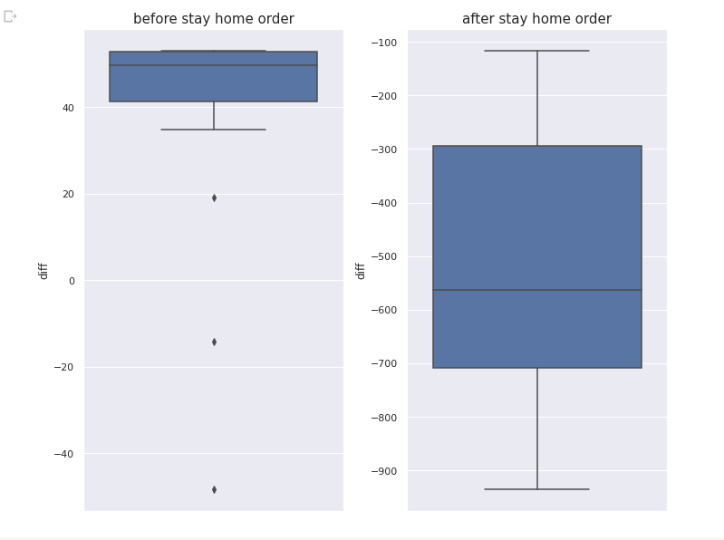

Does stay home order help to control the surge in cases and deaths
ANOVA Testing 7 day moving average before/after 14 days
The cases increased after stay home order, this should be due to the natural increase of cases during the first surge.

Slide 14
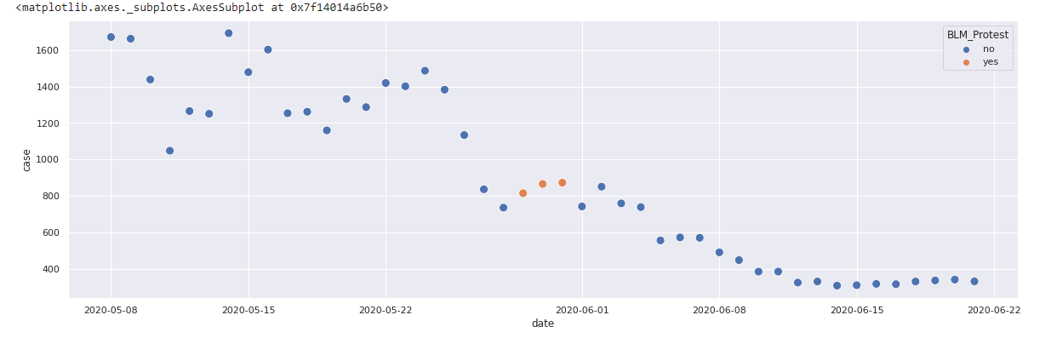
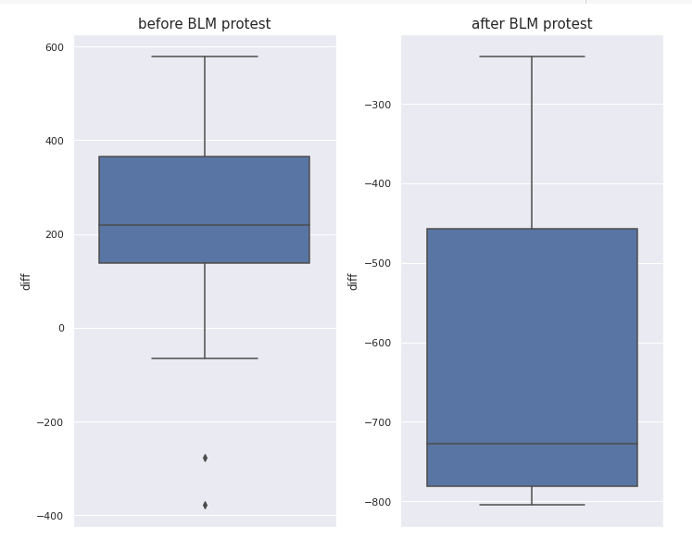

Does BLM movement affect surge in cases and deaths?
ANOVA Testing 7 day moving average before/after 14 days
No, BLM movement does not contribute for the surge.

Slide 15
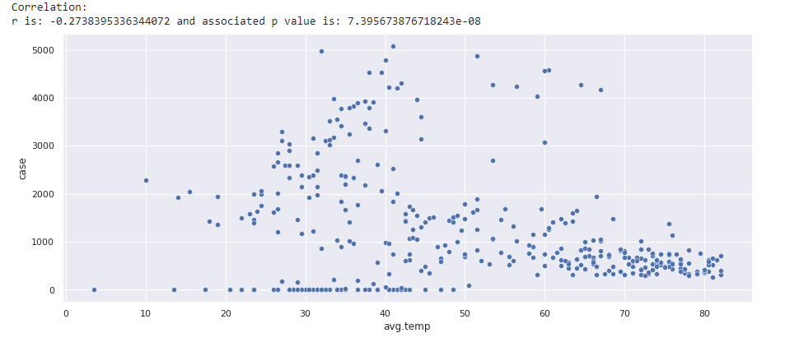
Does temp affect surge in cases and deaths?
Yes, they are negatively linearly correlated ( corr=-0.45)

Slide 16
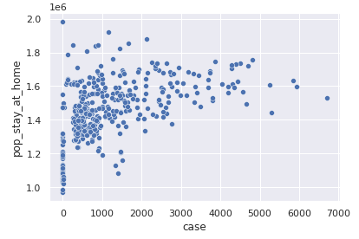
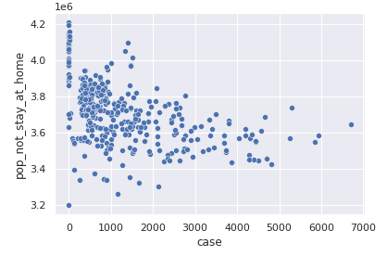
Does population staying/not staying at home is related to surge in cases and deaths?
Yes, they shows cause and effect relationship. When cases are rising population staying at home are also increasing and vice-versa.

Slide 17
Does population staying/not staying at home is related to surge in cases and deaths?
Yes, they shows cause and effect relationship. When cases are rising population staying at home are also increasing and vice-versa.

Slide 18
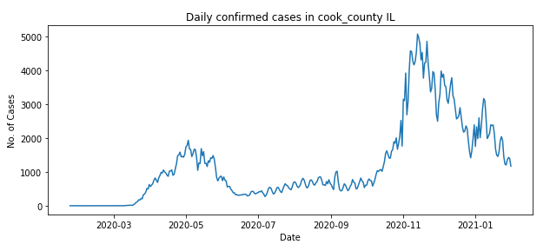
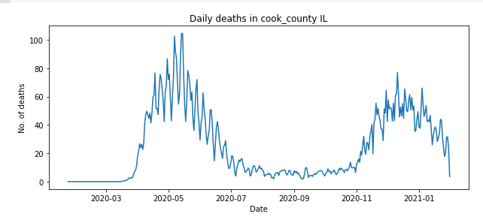
Data Wrangling
Outliers: Cases and Deaths
Handling of Missing Values
3 days rolling average of cases and deaths are used for modelling.
Extreme peak in deaths are replaced by the corresponding 10 days average.
No missing values
Before Averaging
After Averaging

Slide 19
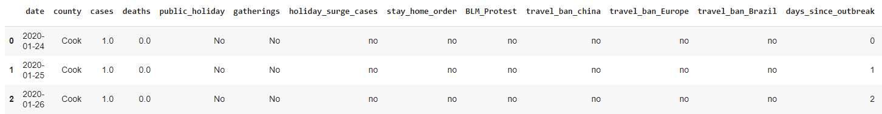
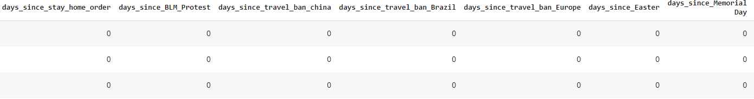
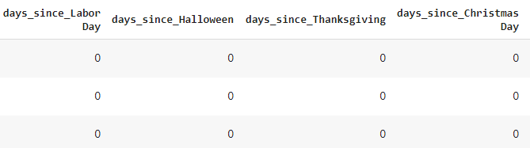
Feature Engineering
Feature Engineering
Public Holidays/Covid related events:
Boolean feature indicating whether the corresponding day is public holiday or not was extracted.
Among public holidays, some of the holidays only contributed for the surge in cases, hence another feature ‘holiday_surge_cases’ was extracted. This feature was generated considering 14 days period after the selected public holiday.
Various Boolean features were generated from various Covid related events such as: Stay home order, BLM protest, travel bans.
Finally, days since various incidents such as outbreak, the public holidays and various events were extracted.

Slide 20
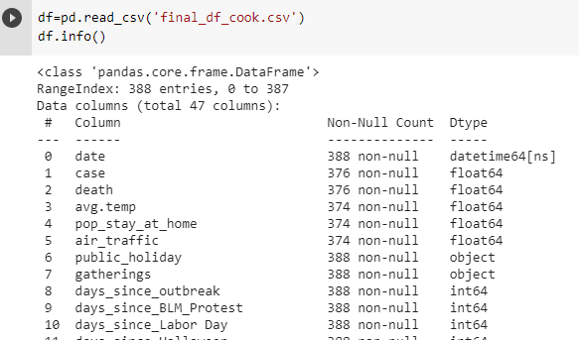
Feature Engineering
Feature Engineering
Mobility:
Ratio of the population staying and not staying home was extracted
The corresponding date was converted into Year, Month and Day.
Lagged_ feature:
14 days lagged value of all the all the features were extracted.
Preprocessing
Finally, all the categorical features were replaced by the dummy variables and highly correlated features (corr>0.98) were dropped.
The final data frame consisted of 387 features.

Slide 21
Modelling
Modelling Overview
Type: Supervised Learning
Model Evaluation Metrices:
Mean absolute percentage error (mape) as a primary model performance parameter.
The dataset was divided into train and test set (70/30), algorithm was trained into train data and the performance was tested on test data.
Baseline Model:
naïve average model
Algorithms used:
ARIMA/SARIMAX
Prophet
LSTM
XGBoost
Light GBM
Hyperparameter Tuning:
Auto_arima, RandomsearchCV
Feature Selection:
Feature importance

Slide 22
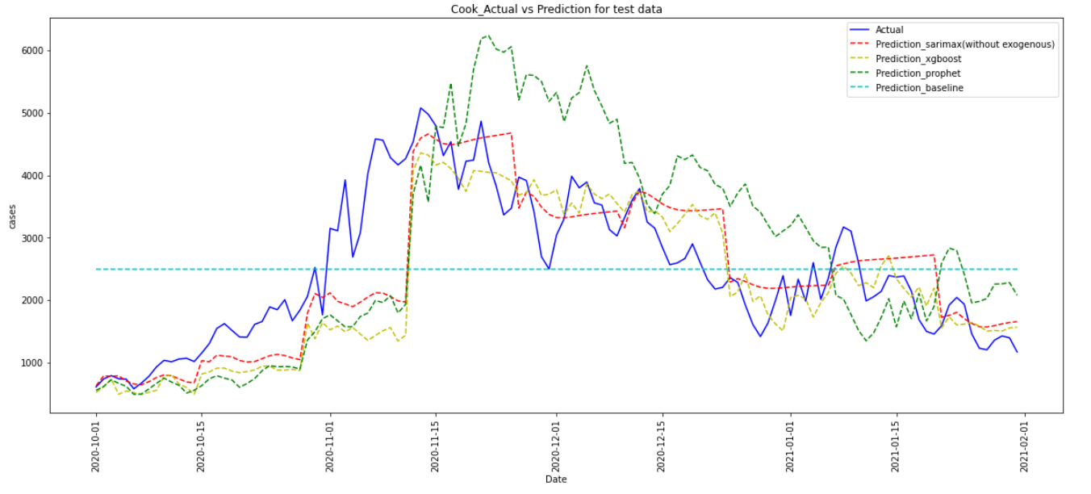
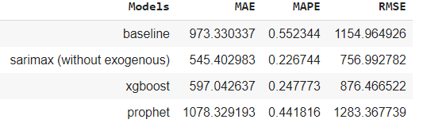
Model Comparisons
Selected Model Performance: Cook_County Illinois

Slide 23
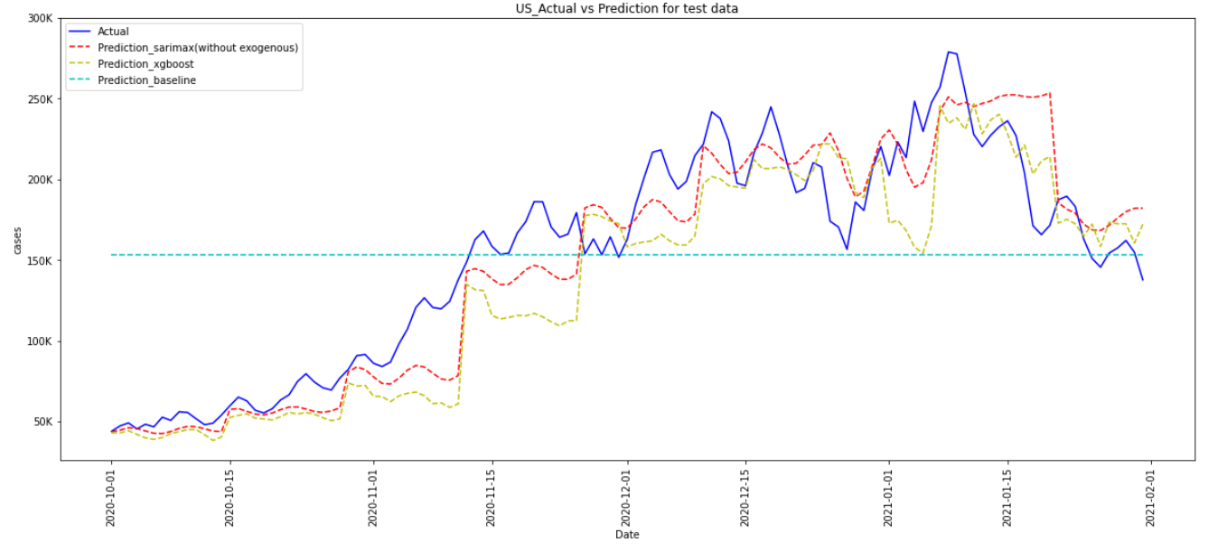
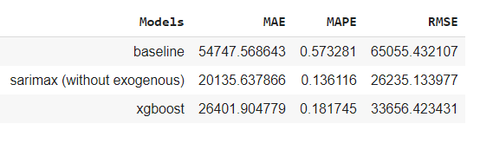
Model Comparisons
Selected Model Performance: US

Slide 24
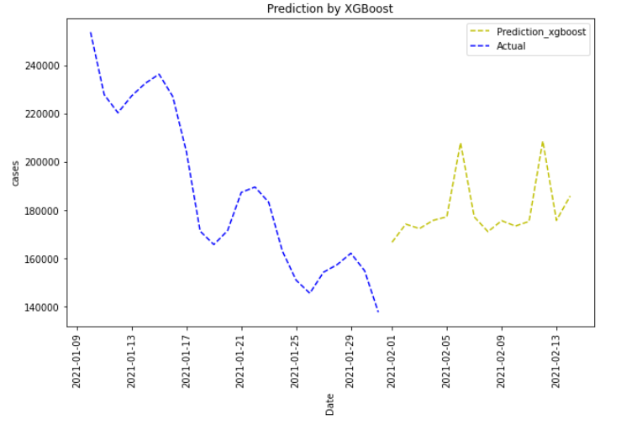
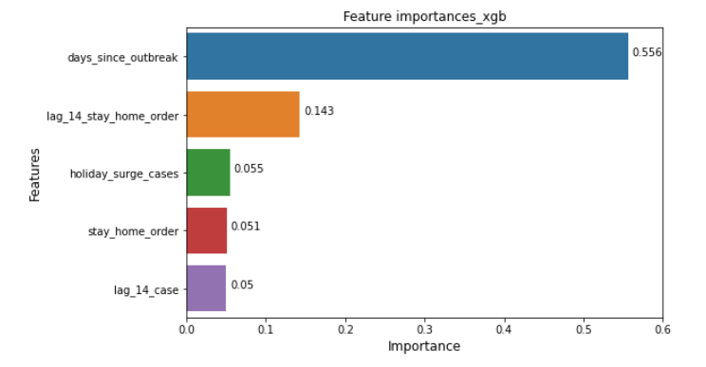
Future Predictions
Cook_county-Cases
US-Cases

Slide 25
Conclusions
All sources of datasets contributed to the predictive power of the model.
Out of 5 supervised classification models, ARIMA model of (3,1,4) yielded least error mape(0.22), however the trend of the cases are captured well by XgBoost (mape 0.25).
Predictions are better for total US cases, mape<0.15.
Top factors that affect the cases are Days since outbreak, lag_14 cases, lag_14_holiday_surge_cases and stay home order.
Inferential analysis shows that the some of the public events/gatherings contributed for the case surge, however this surge is partly linked with the natural spread of the virus as well.
This project helps to predict the cases for the future 14 days effectively which might help to prepare early to contain the spread and also to save the lives of the people.
Result shows that the cases and deaths are not declining for the next 14 days, hence precautionary measures should be adopted.

Slide 26
Suggested ideas for improvements
Many aspects of the virus are still unknown and new variants are evolving; hence we can add any further ideas and improve the model.
Some of the datasets like air traffic was not complete, and I was not able to obtain the daily data, hence the performance of the model will be definitely improved if complete data is incorporated.
Single order of the generated features are included in the models, we can calculate interaction of the features and also to the higher order interaction. This will be computationally intense; however, the performance will be definitely improved.
Hyperparameter tuning has been done in the personal machine with the limited memory and computation power, the performance can be improved by utilizing cluster computing framework such as Apache Spark to better tune the hyperparameter.
Performance of the model of total US can be improved by grouping the states showing similar trend and combined to predict US.

Slide 27
Thank you.

